Slide 1


Control of Boundary Layer Separation and the Wake of an Airfoil Using ns-DBD Plasma Actuators
Kenneth Decker
Project Advisor: Dr. Jesse Little
Department of Aerospace and Mechanical Engineering
The University of Arizona, Tucson, AZ
NASA Space Grant Symposium

Slide 2
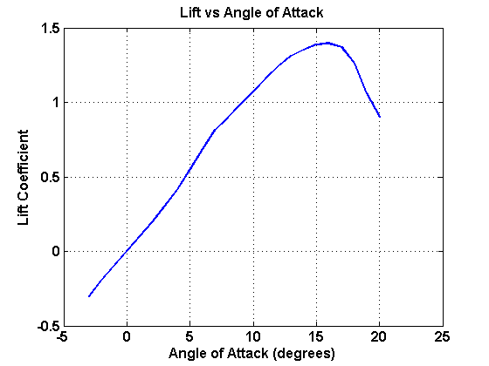
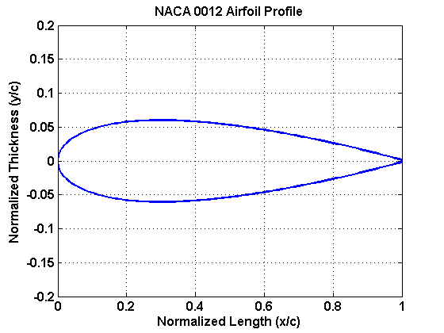

Practical Relevance of Active Flow Control
An airfoil profile is the shape of the cross-section of a wing
Airfoil shapes are chosen so that they produce high lift and low drag
To increase lift, airfoil angle of attack (AoA) is increased
  Increasing too high can cause stall, which reduces lift and increases drag
Mechanical devices (flaps, slats, etc.) can be used to increase lift, but introduce mechanical complexity and weight
Active Flow Control (AFC) can potentially do the work of mechanical devices with greater efficiency and simplicity
Stall Point

Slide 3

Background and Motivation
Greenblatt and Wygnanski, 2000
Boundary Layer Separation occurs when wings are at high angles of attack. This causes flow separation, which causes stall
AFC is known to be able to reattach flow over the wing surface by energizing the boundary layer
  Actuators can work by pulsed blowing, pulsed suction, or both
Actuator performance is often frequency dependent

Slide 4
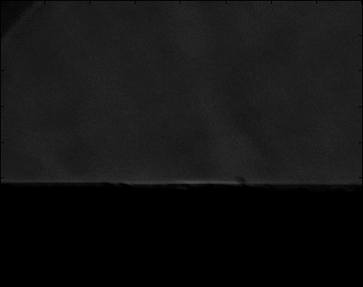

Background and Motivation
Nanosecond Dielectric Barrier Discharge Actuators (ns-DBD)
Unlike many other AFC devices, ns-DBD’s do not work by directly transferring momentum to the boundary layer
Electric Discharge is driven by high voltage pulses with rise times on the order of nanoseconds
Rapid localized heating of gases near surface excites natural instabilities in the flow

Slide 5
Research Objectives
Primary Objectives:
  Replicate previous results using ns-DBD’s to control flow separation over NACA 0012
  Explore ability of ns-DBD’s to control structures in airfoil wake
Practical Ramifications
  Excite natural instabilities to improve performance using a low energy, low weight alternative to mechanical systems
  Explore the nature of vortex structures over a range of frequencies
  Study the ability of ns-DBD’s to create unsteady flow fields with certain controlled characteristics

Slide 6
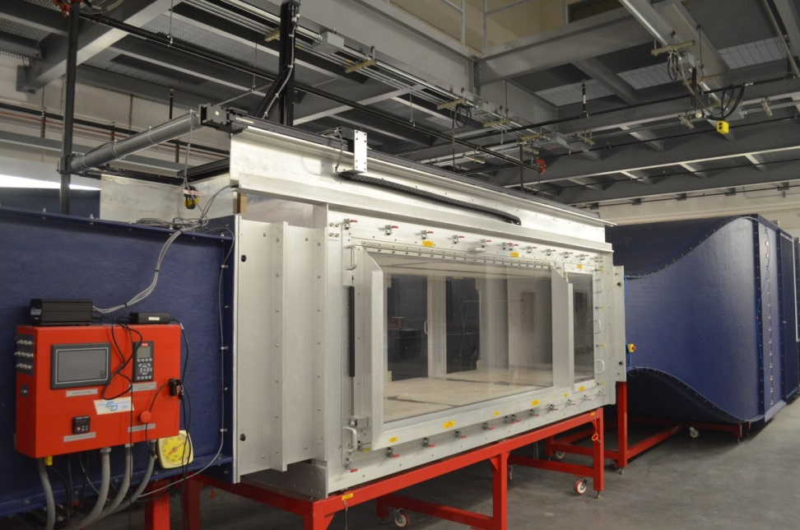
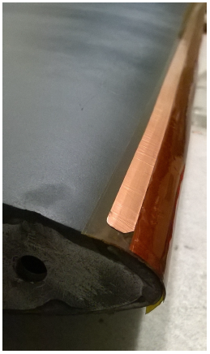
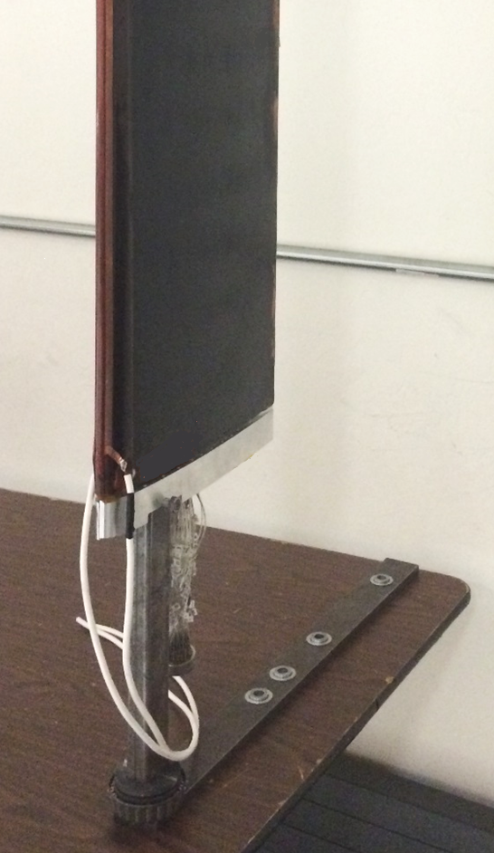

Experimental Facility
Actuator on airfoil LE
Soldered Transmitter Cables
High Voltage electrode
Aluminum Spacer
Vinyl Pressure Tubes
Ground electrode
Closed-loop subsonic wind tunnel, max velocity U = 80 m/s
3’x4’x12’ test section
Turbulence intensity ≤ 0.15%
Tests conducted at U = 40 m/s
Pulse energy: .3 mJ/cm
AoA = 18⁰, c = 12 in, b = 34 in
Nominal 2D actuation across airfoil span of leading edge
Airfoil fitted with 64 taps to measure surface pressure

Slide 7
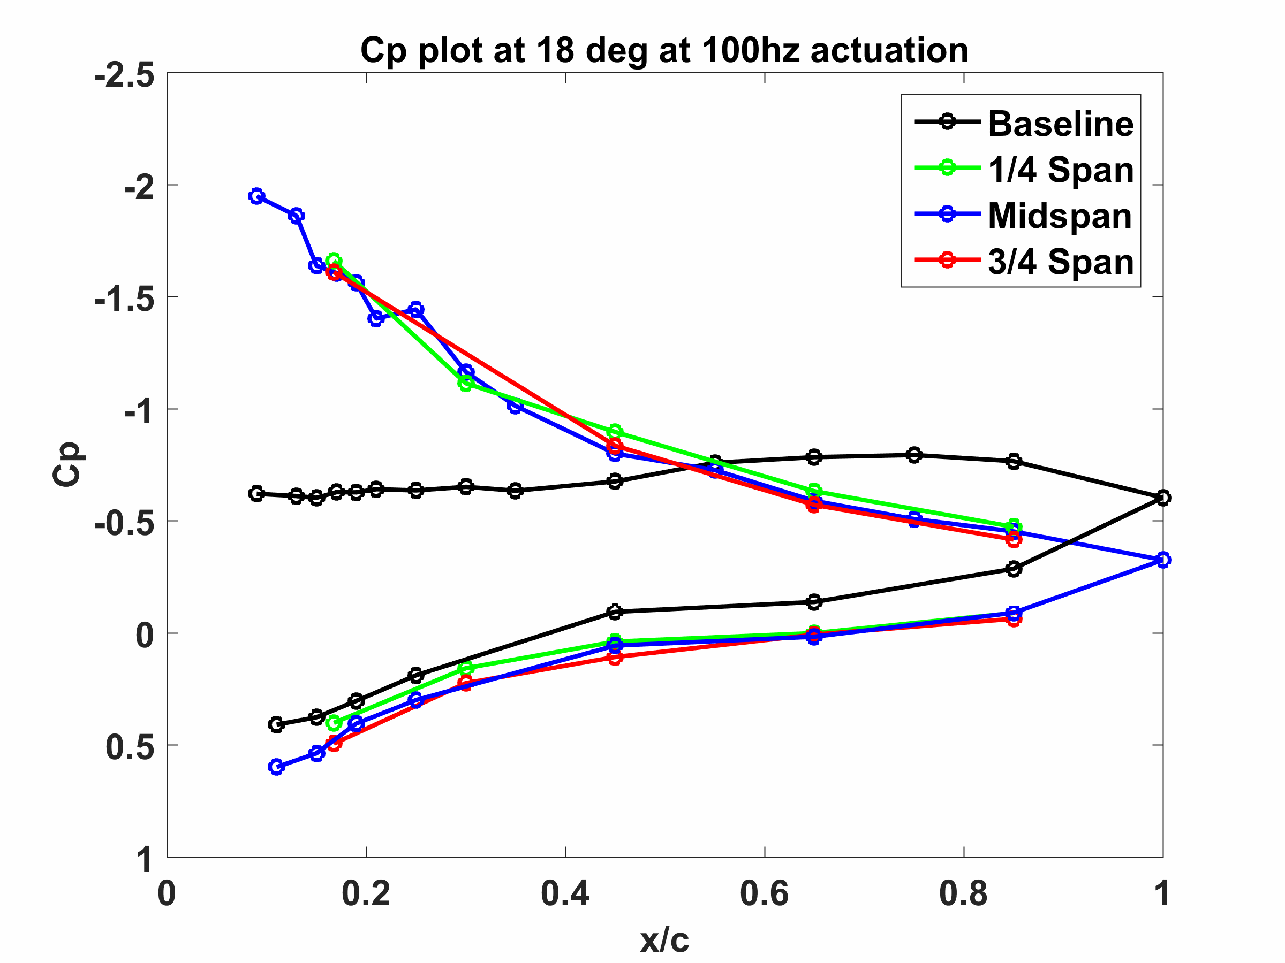
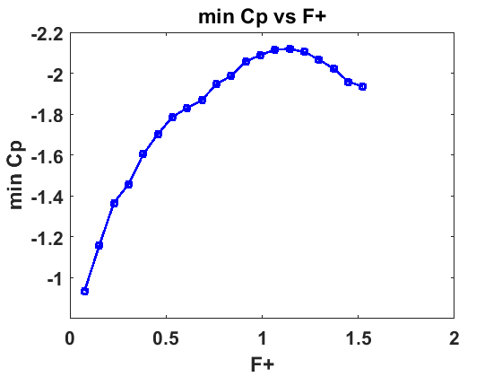

Separation Control
Frequency sweep performed from F⁺ = .08 – 7.62 (f_{f} = 10 Hz – 1000 Hz)
Lowest minimum C_{P} occurs at F⁺ = 1.14 (f = 150Hz)
  Strong frequency dependence indicates that flow instabilities are being excited

Slide 8
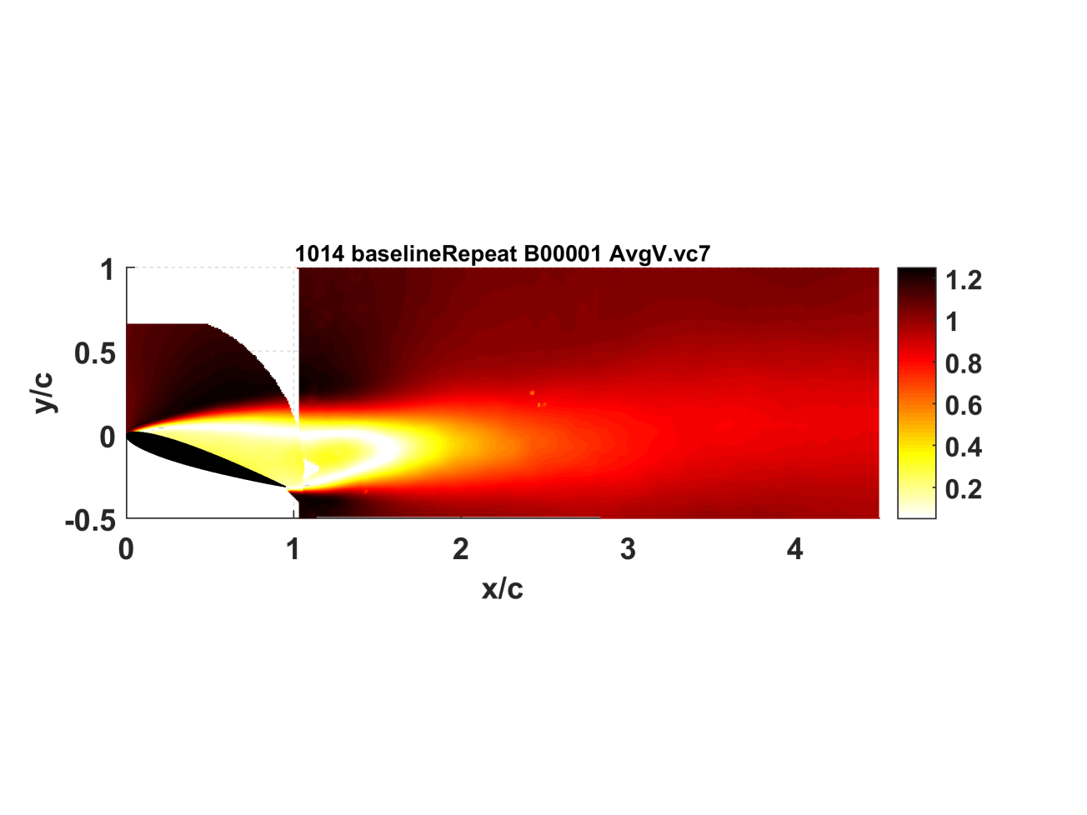
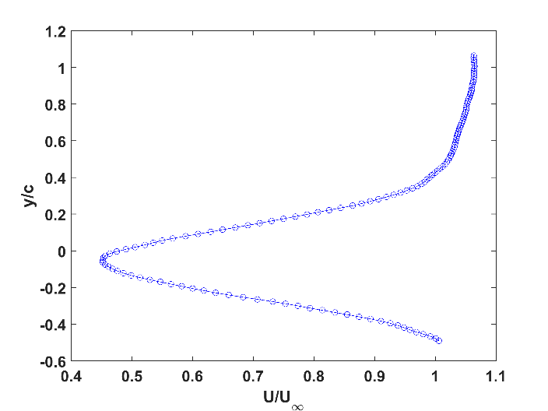
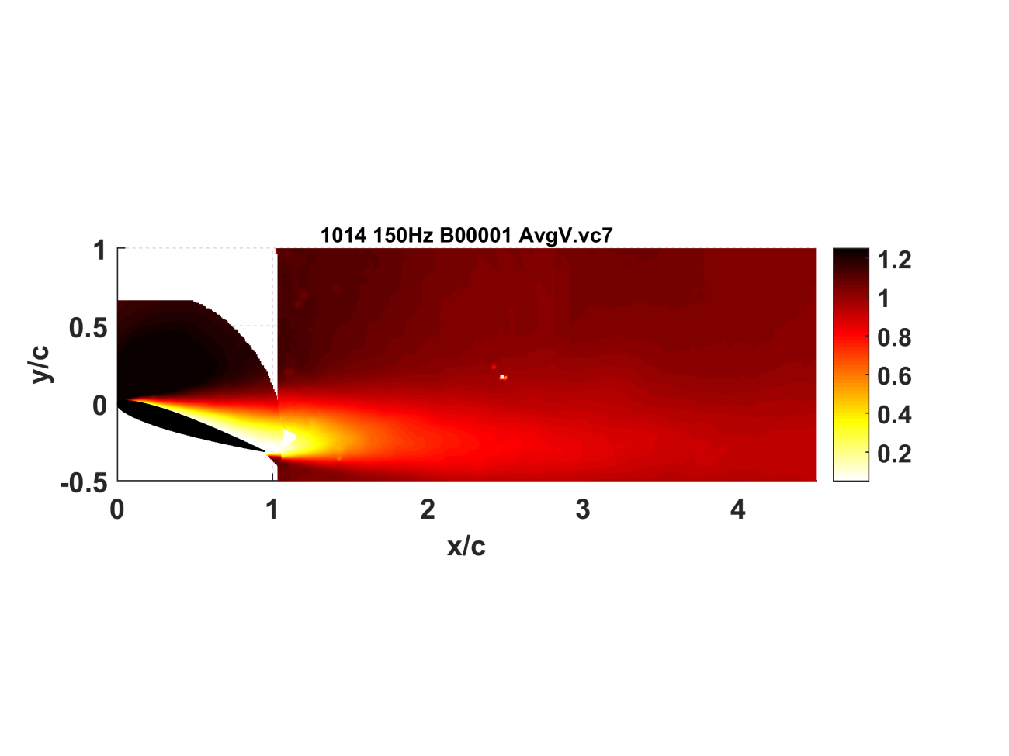
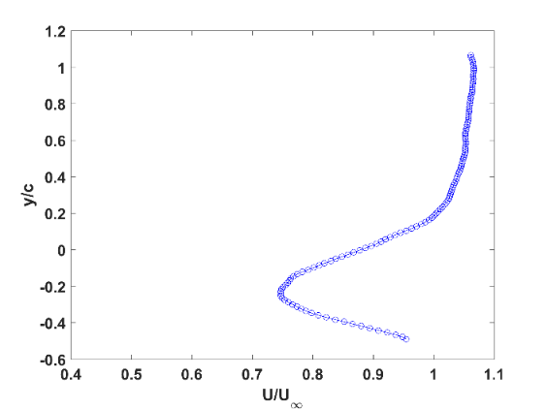

PIV for Optimal Separation Control (f = 150 Hz)
Velocity Profiles at x/c = 2
Average Normalized Velocity in Wake
Baseline
f = 150 Hz, F⁺ ~ 1.14

Slide 9
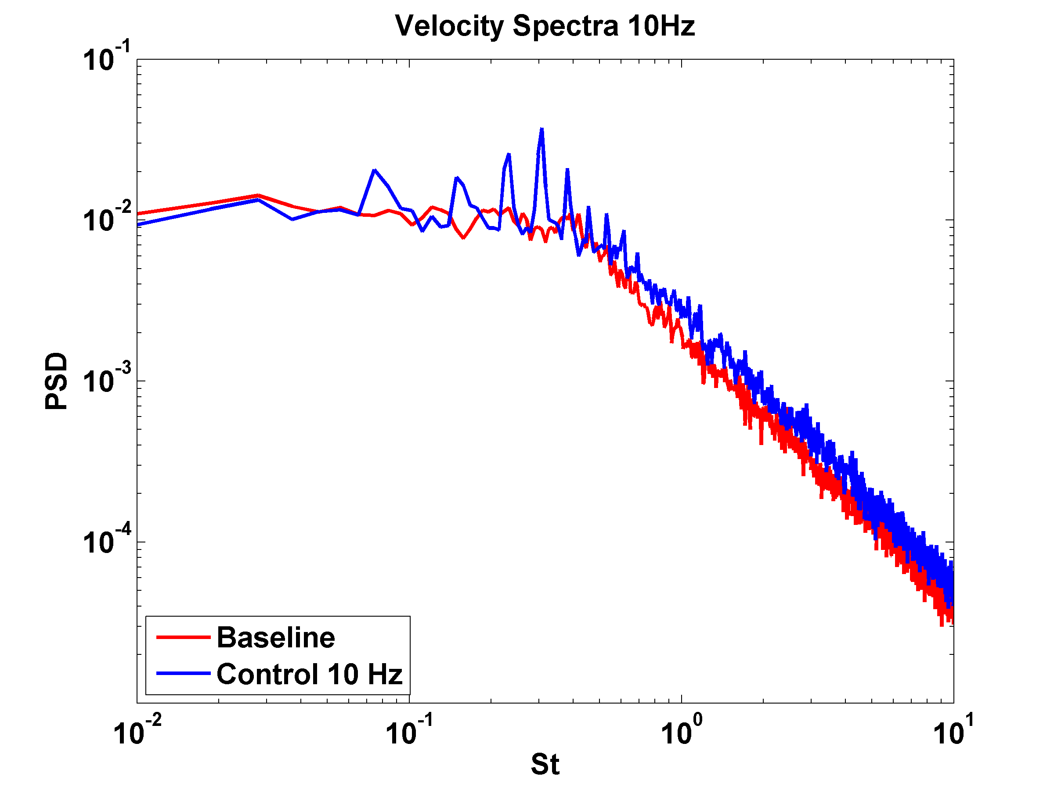
Wake Control
CTA is used to measure streamwise velocity fluctuations from F⁺ =.08 – 1.22 (10 Hz – 160 Hz)
F⁺ < .23 (f < 30 Hz)
  Fluctuations produce multiple peaks at harmonics of forcing
.023 < F⁺ < .92 (30 < f < 120 Hz)
  Single dominant frequency peak is produced in wake at the forcing frequency
F⁺ > .92 (f > 120 Hz)
  No distinguishable frequency peaks produced in the wake

Slide 10
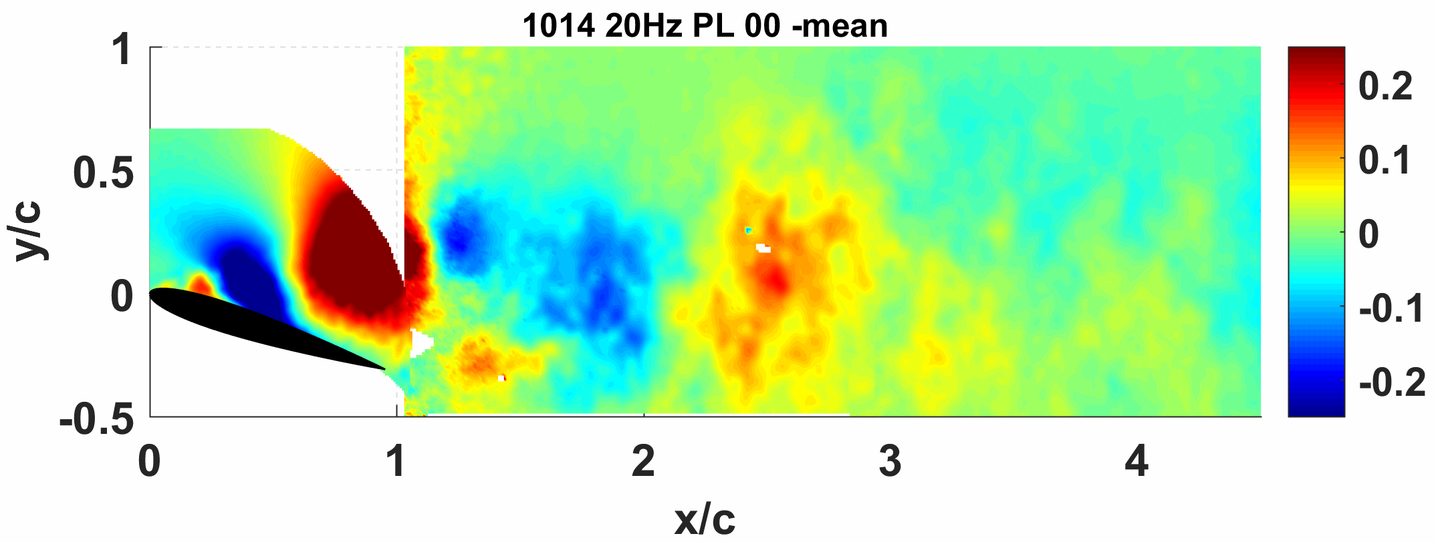
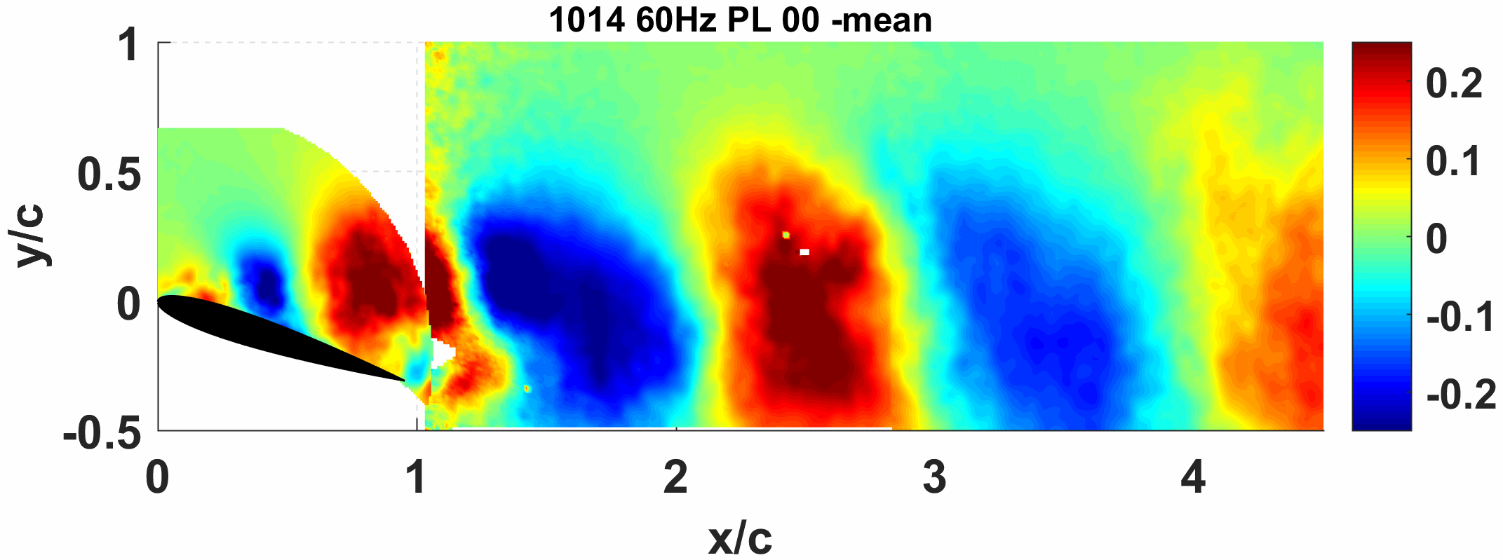
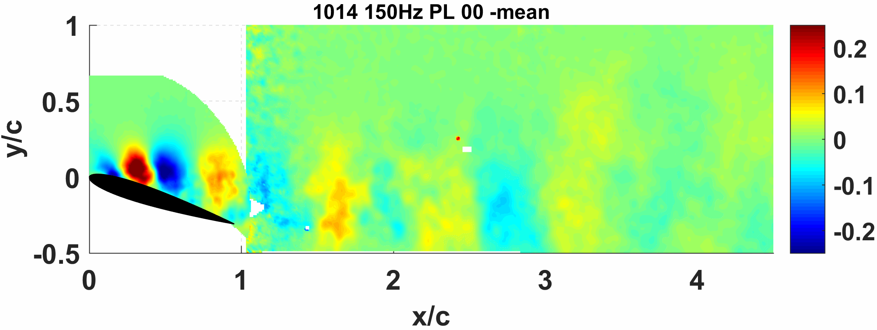
PIV Wake Control Cases
F⁺ ≈ 0.15 (f_{f} = 20 Hz)
F⁺ ≈ 0.46 (f_{f} = 60 Hz)
F⁺ ≈ 1.14 (f_{f} = 150 Hz)

Slide 11
Conclusions
Static Pressure Measurements verified previous experimental results that ns-DBD actuators exhibit control authority over flow separation over an airfoil
Static Pressure Distributions and hot wire data exhibit nominally 2D behavior at the model midspan
  Separation control at F⁺ ~ O(1)
  Vortex Generation in wake at F⁺ ~ O(.1)
PIV visualization of structures supports hypotheses
CTA measurements indicate 3 regimes of excitation in wake:
  Impulse like behavior at low forcing frequencies (F⁺ < .23)
  Coherent vortex generation consistent with forcing (.23 < F⁺ < .92)
  Separation control with no coherent structures in wake (F⁺ > .92)
  Not necessarily mutually exclusive

Slide 12
Acknowledgements
Sponsors
  NASA Space Grant Consortium
  Army Research Office (ARO)
  University of Arizona College of Engineering and Department of Aerospace and Mechanical Engineering
Graduate Students
  Timothy Ashcraft (MS, University of Arizona)
  Sebastian Endrikat (MS, TU Berlin)
  Ashish Singh (PhD, University of Arizona)
Undergraduate Students
  Zachary Wellington (BS, University of Arizona)
  Marcel Dengler (BS, TU Berlin)

Slide 13
References
Ashcraft, T., et al (2015). “Controlling Boundary Layer Separation and the Wake of an Airfoil using ns-DBD Plasma Actuators.” AIAA SciTech Convention.
Gad-el-Hak, M. (2000). Flow Control: Passive, Active, and Reactive Flow Management. Cambridge, UK, Cambridge University Press
Greenblatt, D., et al. (2000). "The Control of Flow Separation by Periodic Excitation." Progress in Aerospace Sciences 36: 487-545.
Gregory, J., et al. (2007). Switching Behavior of a Plasma-Fluidic Actuator. AIAA 45th Aerospace Sciences Meeting. AIAA Paper: 11.
Gursul I, Rockwell D (1990) Vortex street impinging upon an elliptical leading edge. Journal of Fluid Mechanics 211:211-242 DOI:10.1017/S0022112090001550.
Little, J., Takashima, K., Nishihara, M., Adamovich, I. and Samiimy, M., "Separation Control with Nanosecond-Pulse-Driven Dielectric Barrier Discharge Plasma Actuators," AIAA Journal, Vol. 50, No. 2, 2012, pp. 350-365.
Rethmel, C., Little, J., Takashima, K., Sinha, A., Adamovich, I. and Samimy, M., "Flow Separation Control using Nanosecond Pulse Driven DBD Plasma Actuators," International Journal of Flow Control, Vol. 3, No. 4, 2011, pp. 213-232.
Rockwell D (1998) Vortex-Body Interactions. Annual Review of Fluid Mechanics 30:199-229
Roupassov, D., Nikipelov, A., Nudnova, M. and Starikovskii, A., "Flow Separation Control by Plasma Actuator with Nanosecond Pulsed-Periodic Discharge," AIAA Journal, Vol. 47, No. 1, 2009, pp. 168-185.
Wilder M, Telionis D (1998) Parallel Blade-Vortex Interaction. Journal of Fluids and Structures 12:801-838.
Wu J, Lu X, Denny A, Fan M, Wu J. Post-stall Flow Control on an Airfoil by Local Unsteady Forcing. Journal of Fluid Mechanics 1998;371:21-58.

